Slide 1
Nodejs IDG

Slide 2
Topics of Discussion
What is Nodejs?
History
REPL - Read Eval Print Loop
Pros and Cons
Applications
Examples:
A short demo of MusicBot chatbot
Cowsay using requests library
Nodejs Style Guide
References and Other Important Links

Slide 3
What is Nodejs
Open source & cross-platform project.
JavaScript runtime built on Chrome's V8 JavaScript engine.
Event driven & Non-blocking IO.
Real time apps. Like video streaming(Netflix), chat applications, real time multiuser coding applications etc.
Single threaded.
Built in Async IO, HTTP/s, file-system etc. Nodejs APIs
Ability to do JavaScript on server.
Act as a web server. Expressjs

Slide 4
Single threaded
Nodejs is a single threaded environment meaning that two processes can’t run parallely on different threads.
However, there are ways to implement concurrency in Nodejs code.
Concurrency - at the same time;simultaneously.

Slide 5
Cross-platform
Nodejs is cross-platform meaning it works across all major Operating systems namely, Windows, Linux, OSX.

Slide 6
Nodejs Event-driven
Event driven programming is a generic concept where event emitter emits the number of events and a main loop listens to these events and immediately triggers a callback function as soon as the corresponding event is detected in that loop.
Callback - A function called after a particular task is completed. Discussed later in the slides.
Event loop - When Nodejs starts, it initializes an event loop which keeps looping (REPL) over the code and listens for events occurrence. After an event occurs, its callback is called if a callback is indeed present. After the event loop is exhausted, Nodejs event loop exits and the program terminates.

Slide 7
Blocking I/O (input/output)
Blocking - Blocking is when the execution of additional JavaScript in the Node.js process must wait until a non-JavaScript operation(Input/Output) completes. This happens because the event loop is unable to continue running JavaScript while a blocking operation is occurring.
Example: Suppose we have a program which writes to a file and takes 2 minutes to do that. In blocking I/O, the JS code following this write process will not execute until the write process is completed. This is meant by blocking. This is also known was synchronous programming.

Slide 8
Non-blocking I/O
In non-blocking I/O, the code will not be blocked for an input/output operation to occur. The Nodejs will process all the code without waiting for any long process to occur.
Example: The previous example of file write can be used here too. In the example, the Nodejs event loop will run through all the code and not wait 2 minutes for the file I/O to complete. Such a style is called asynchronous programming.

Slide 9
Blocking vs. Non-blocking
Both the types of programming have their own pros and cons.
Blocking pros - We can evade the unnecessary program complexity where we have to keep in mind that all the code that must execute after the I/O for normal execution somehow gets executed after the I/O completes(This leads to the concept of callbacks in Nodejs).
While the con of such I/O is painfully long waits in the code execution completion.
Non-blocking pros - We get a light-weight and efficient application due to no waits.
Cons - While writing code in callbacks, we can get into a situation where one process must complete before other and there are say 5, processes. This would lead to unnecessary code complexity. Leads to callback hell.

Slide 10
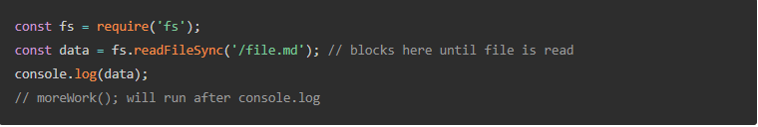
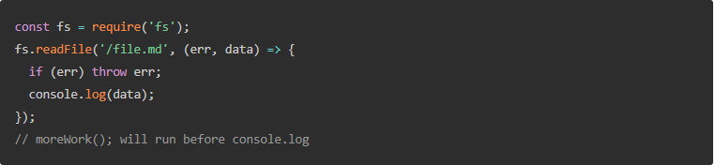
Example of Blocking and Non-blocking

Slide 11
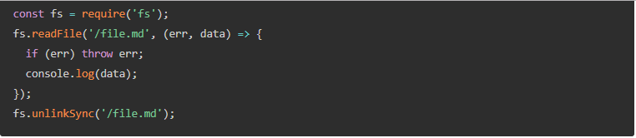
How non-blocking code can produce bugs
Cksdnclkcsa
Code snippet is taken from :
https://nodejs.org/en/docs/guides/blocking-vs-non-blocking/

Slide 12
Alternative to Callbacks - Promises
A promise is an object that may produce a single value some time in the future: either a resolved value, or a reason that it’s not resolved (e.g., a network error occurred). A promise may be in one of 3 possible states: fulfilled, rejected, or pending.
We would not discuss the Promises in details in this module because it will go a little out of scope and it is a topic in itself.
However, there are a few links in the reference section if you want to learn the Promises in depth.

Slide 13
Nodejs History
Created by Ryan Dahl, first 2009 for only Linux.
Sponsored by Joyent.
June 2011, Microsoft partnered with Joyent to help create a native Windows version of Node.js.
Nodejs Foundation

Slide 14
Nodejs REPL

Slide 15
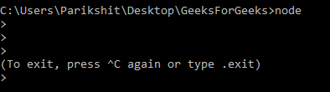
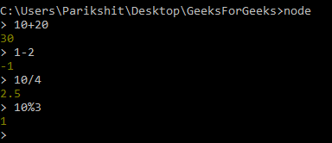

Slide 16
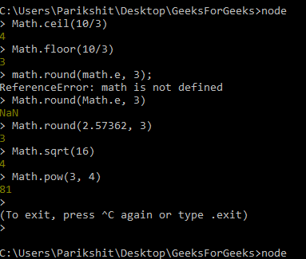

Slide 17
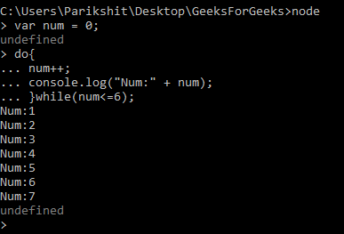

Slide 18
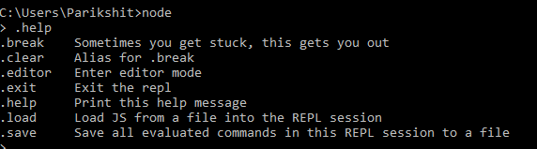

Slide 19
Pros
Asynchronous event driven.
Can share the same piece of code with both server and client side. Everything JavaScript.
Active and vibrant community.
Stream big files.
npm has already become huge and still growing.
Best solution: Web Socket server, Fast file upload client, Data streaming, Ad Server, Real time social app, Stock exchange software etc.

Slide 20
Cons
Tons of nested callbacks. Called callback-hell.
Not suited for CPU-intensive tasks. A major reason is single-threaded nature of Nodejs.
Async programming are more complex.

Slide 21
Nodejs Applications
Streaming applications
Chat applications
API development
Chatbots
Single page and Real time applications
Some great links to view:
http://blog.teamtreehouse.com/7-awesome-things-can-build-node-js
https://brainhub.eu/blog/9-famous-apps-using-node-js/

Slide 22
Examples

Slide 23
Cowsay using requests library
Featured on :GeeksForGeeks

Slide 24
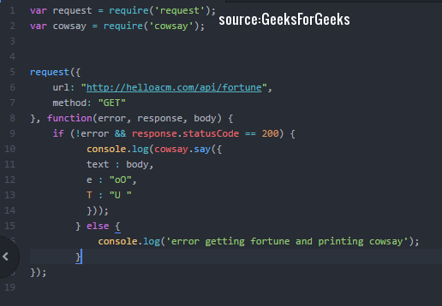

Slide 25
MusicBot
https://docs.microsoft.com/en-us/azure/bot-service/bot-service-channel-connect-facebook - connecting the fb chatbot to your application.
https://github.com/Parikshit-Hooda/musicbot-open-code/tree/master - app.js to drive the code.

Slide 26
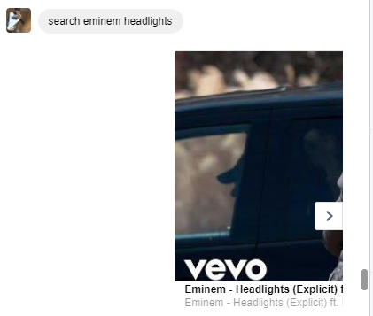

Slide 27
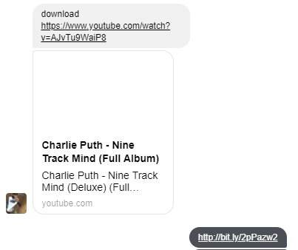

Slide 28
Nodejs Style Guide
The below link will help the developers to follow a correct pattern to write Nodejs code. Topics included are:
Formatting and code indentation
Naming conventions of variables, functions
How to write comments
Note: The style guide is a reference. A beginner should focus more on grasping the concepts rather than writing the code. However, there is no harm in following a pattern as it makes the code consistent and easy to understand.
https://github.com/felixge/node-style-guide

Slide 29
References
https://nodejs.org/en/docs/guides/blocking-vs-non-blocking/
http://faculty.salina.k-state.edu/tim/ossg/Device/blocking.html
https://github.com/felixge/node-style-guide
https://developers.google.com/web/fundamentals/primers/promises
https://colintoh.com/blog/staying-sane-with-asynchronous-programming-promises-and-generators
https://medium.com/javascript-scene/master-the-javascript-interview-what-is-a-promise-27fc71e77261
Nodejs REPL - https://www.tutorialspoint.com/nodejs/nodejs_repl_terminal.htm

